Slide 1

Title I Parent Meeting
School Name
Presenter Name| Event Name | Meeting Date

Slide 2

What is Title I?

Slide 3

What is title I?
Title I provides additional academic support and learning opportunities for students.
The program is intended to help ensure that all students meet the California Common Core State Standards.
Goals of Title I:
Increase academic achievement
Provide direct instructional support to students
Provide professional development to teachers
Promote parent education and involvement

Slide 4

Title I parent involvement

Slide 5

Parent Involvement
Parents have the rights to….
Ask for meetings and trainings
Review the school’s academic achievement data
Review the parent involvement plan and activities included in the School Plan for Student Achievement
Review and modify the school’s Title I Parental & Family Engagement Policy and School-Parent Compact

Slide 6
Parent Involvement
School Site Council (SSC)
Provides parents with an opportunity to be involved in the academic program of the school.
Develops, monitors, and evaluates the School Plan for Student Achievement (SPSA) to implement programs and services that support students.
Collaboration (work together) between schools and families is essential to increase student achievement.
At our school, parents are involved in the following activities:
Parent Conferences
Workshops
Coffee Conversations
PTO/PTA
Volunteer
Be informed….our school is using the following to communicate with you:
Blackboard
Website
Twitter

Slide 7
Parent Involvement
PARENT AND FAMILY ENGAGEMENT POLICY
Every Title I school, in collaboration with parents, must prepare a site-level parental and family engagement policy.
The Policy describes how the school will involve parents in a meaningful, ongoing, and timely way.
The policy also describes how parents will be involved in the planning, review, and improvement of the school’s Title I program and activities
SCHOOL – PARENT COMPACT
The Compact describes how the school and parents share the responsibility for student achievement
It is developed in collaboration among parents, teachers, and students
The Compact is distributed annually with the Title I Parent and Family Engagement Policy

Slide 8

School Plan for Student Achievement

Slide 9

School Plan for student achievement
Annually evaluate the program goals
Comprehensive Needs Assessment
Review of School Performance Data (Dashboard, Comprehensive School Profile, etc)
Goals and strategies to address student academic needs
Description of core and supplemental programs
Description of instructional strategies and interventions to assist struggling students
Professional needs and activities
Parent involvement strategies and activities
Alignment of Fiscal Resources with strategies
SPSA Development –
FOUR Required Actions:
The SPSA must be meaningfully developed with parent input.
The SPSA must be shared with ELAC, with opportunity for ELAC recommendations.
The SPSA must be approved by the School Site Council, after ELAC recommendations are presented and considered.
The SPSA must be approved by the district’s governing board.
Available Electronically: https://www.stocktonusd.net/Page/10028

Slide 10
School Plan for student achievement
Data Driven Decision-Making Process:
Schools analyze the SBAC, ELPAC, iReady assessment results, attendance and suspension rates to review school-wide performance data with educational partners
The data analysis is used to determine successes and challenges for the school site. Focused on curriculum, state standards, school climate, and family engagement
The school with the input of educational partners makes a plan to adjust instructional practices on the findings from the decision-making process to improve student achievement
District Curriculum:
ELA/ELD:
  Benchmark Advance
  MyPerspectives
Mathematics
  Ready Math
  Pearson Math

Slide 11
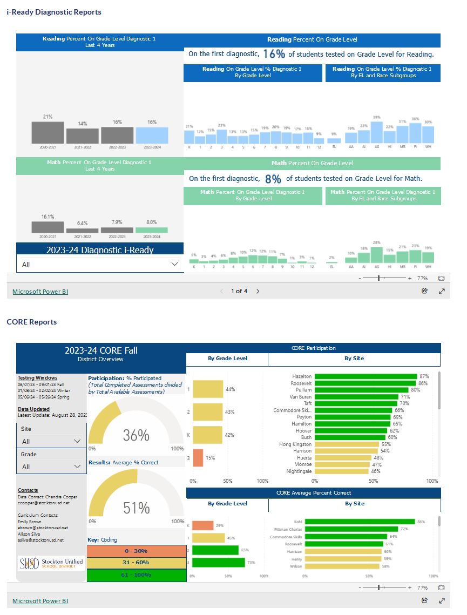
School Plan for student achievement
Remove this direction box:
Locate the school performance data and add additional slides as necessary
For assistance contact Research

Slide 12

School Name Title I Funding and School Plan

Slide 13

Title I Funding allocation
Schools are allocated funds based upon the percentage of student receiving free or reduced lunch
Schools are ranked according to this percentage and receive a per pupil allocation
One percent of the school’s total Title I budget is for parent involvement activities
Total Title I Allocation:
$[Total of Title I and Title I Parent funds]

Slide 14
SPSA School Strategies
Our SPSA includes the following strategies/activities as a Schoolwide Program:
Goal 1: Name of Goal 1
Identify and briefly describe strategies/activities, such as tutoring, intervention, etc.
Goal 2: Name of Goal 2
Identify and briefly describe strategies/activities
Add additional slides as necessary to share all school goals and strategies.
Delete this direction box

Slide 15
THANK YOU!
Insert Principal Name
Insert Contact Number
Insert School Website

